Slide 1
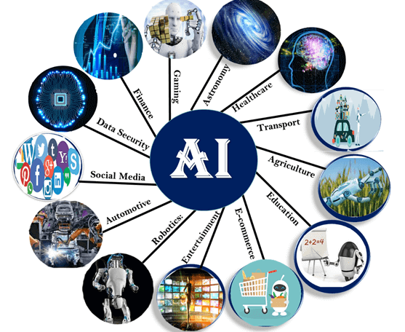
Application of ai
Applications:
AI in astronomy
AI in Healthcare
Ai in Gaming
AI in Finance
AI in Data Security
AI in Social Media
AI in Travel & Transport
AI in automotive Industry
AI in Robotics
AI in Entertainment
AI in Agriculture
AI in E-commerce
AI in education

Slide 2
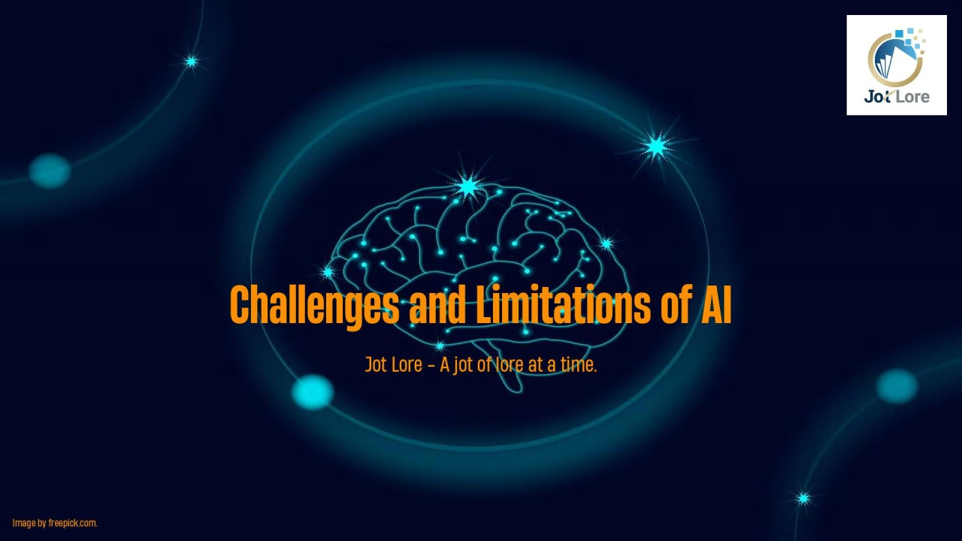
Challenges and limitatons
Challenges and Limitations of AI
Data Dependency:
Explainability and Transparency
Generalization vs. Specialization
Ethical and Societal Implications
Reliability and Safety
Human and AI Interaction:
The Barrier of Common Sense

Slide 3
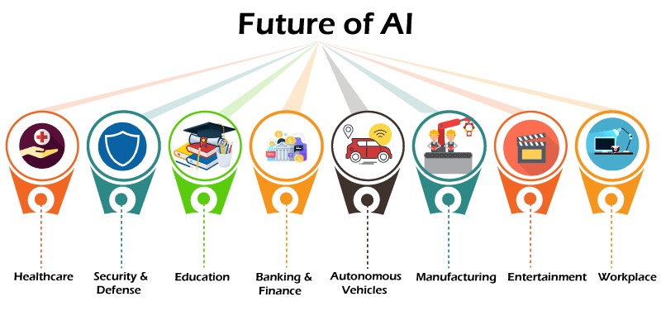
Future outlook
How will AI Impact The Future.
Speed of life
End of privece
Thicket of AI look
Human AI teaming
Which industries will AI have a big impact on?
Education
Health and Care
Fineces
Law
Trosporatation

Slide 4
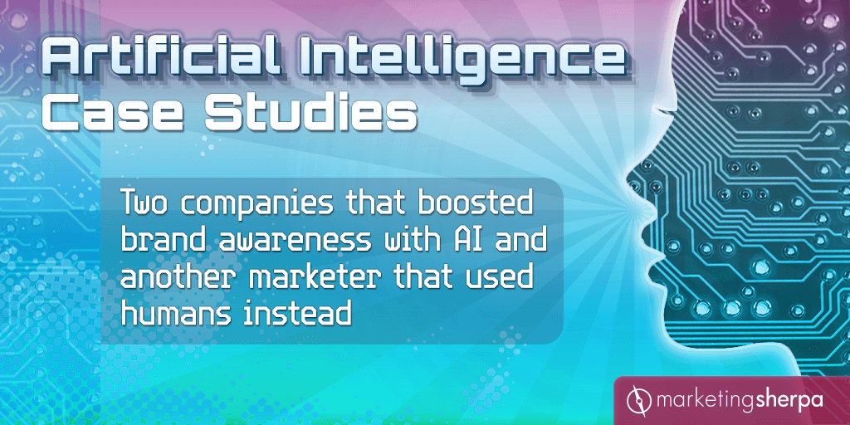
Case studies
Here are some case studies of AI:
Netflix: Uses AI to analyze viewing patterns and preferences to recommend shows and movies. Netflix also uses AI to decide which shows to produce.
Google Maps and Waze: Use AI to analyze real-time traffic data and provide the fastest routes.
Email filtering: Uses AI to filter out spam emails, categorize incoming emails, and suggest quick replies in some email platforms.
Healthcare: Uses AI to optimize supply chains for platelets to reduce costs.
Finance: Uses AI and machine learning for tax automation.
Telecoms: Uses AI for predictive maintenance for network infrastructure providers.
Big Hollywood production companies: Use AI to edit movie trailers and produce pop songs. They also use facial recognition technologies to detect audiences' reactions during test screenings.
Microsoft's Project InnerEye: Uses machine learning to automatically delineate tumors and healthy anatomy in 3D radiological images.
Siemens: Uses smart boxes to bring older motors and transmissions into the digital age.

Slide 5
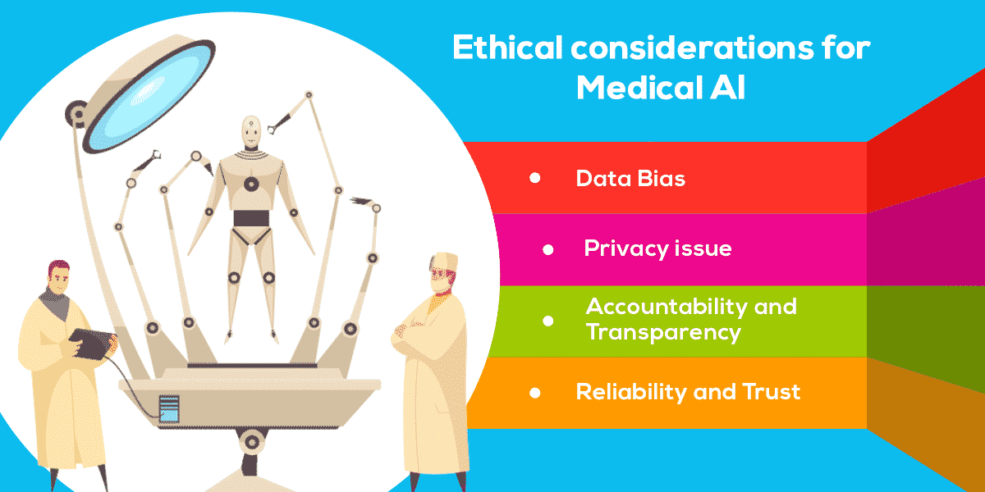
Ethical consideration
Top 10 Ethical Considerations of AI
Fairness and bias
Trasparncy
Privacy
Safety
Explainability
Human oversight
Trustworthiness
Human centered deasing
Responsibility
Considerthed long term impact of AI

Slide 6

Conclusion
AI holds the key to unlocking a magnificent future where, driven by data and computers that understand our world, we will all make more informed decisions. These computers of the future will understand not just how to turn on the switches but why the switches need to be turned on.

